Slide 1


Slide 2
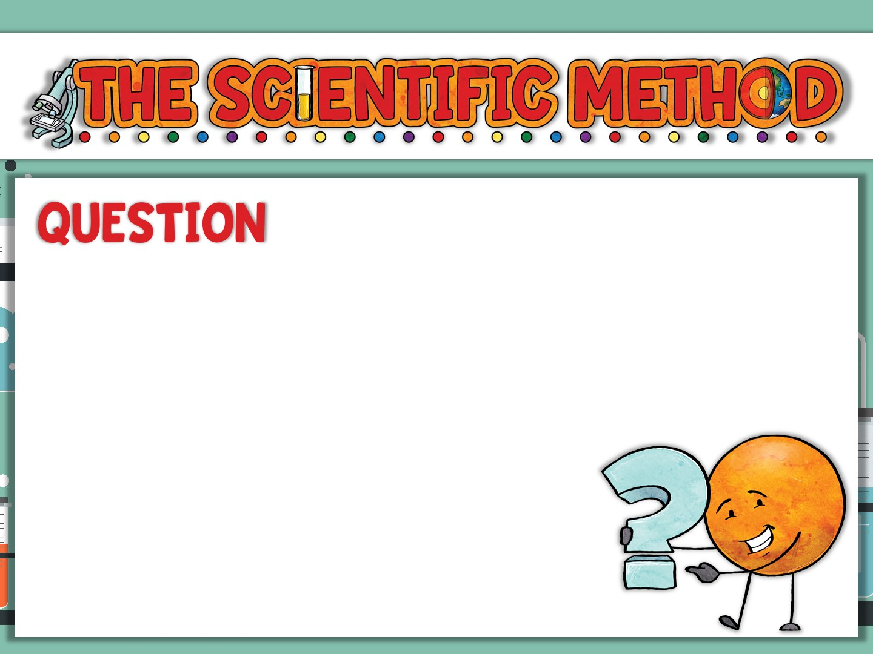
The ________ starts when you ask a __________ about something you _________.
_______? _______?_______?_______?
It needs to be a _________
question, not one based upon
________.
process
question
observe
Why
How
When
What
testable
opinion

Slide 3
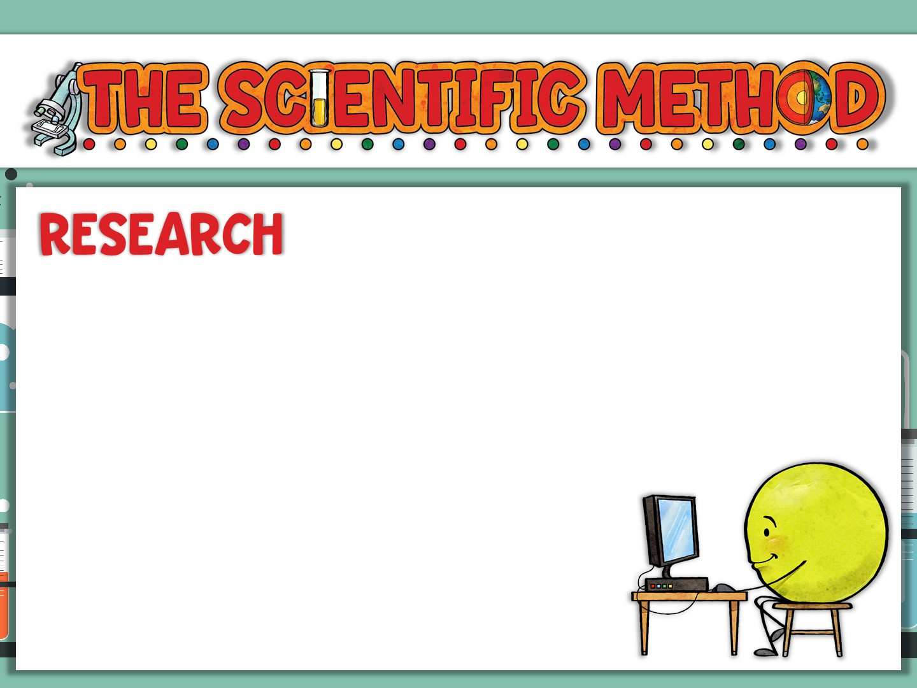
Research what is ________ about your question. ______ from others who may have already conducted ____________. Your question may already have been __________!
You may go back and ask another
_________.
known
Learn
experiments
answered
question

Slide 4
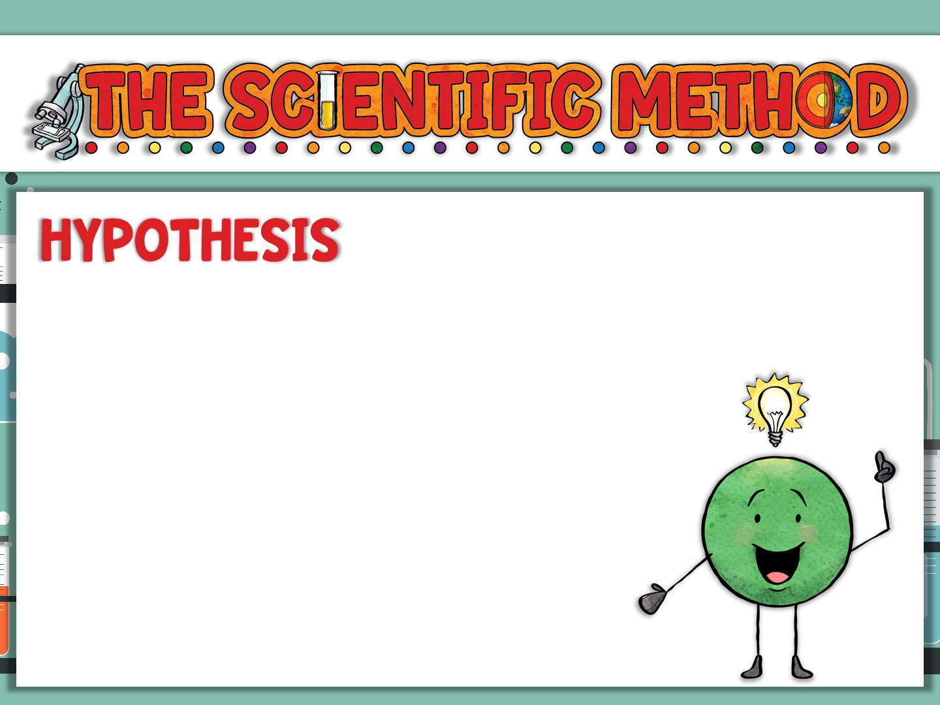
A hypothesis is an educated _______ about the ________ to your question. It is your
__________ about the _________
of any experiments you _______.
It should be ___________ and
not ________ based.
guess
answer
prediction
outcome
design
measurable
opinion

Slide 5
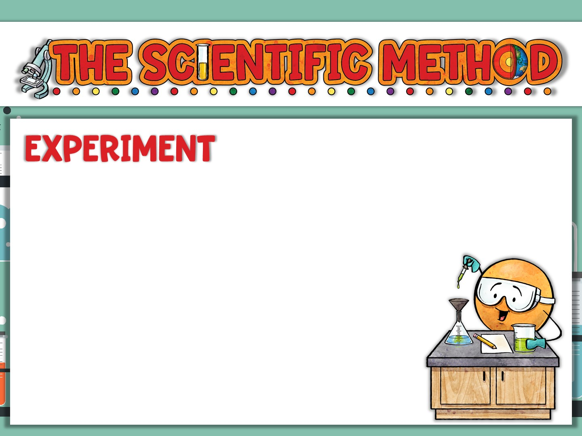
Designed to _____ your hypothesis.
It should be a _____ test with appropriate _________ and _________.
It should be able to be _________
by you and be able to be repeated
by other _________.
test
fair
variables
controls
repeated
scientists

Slide 6
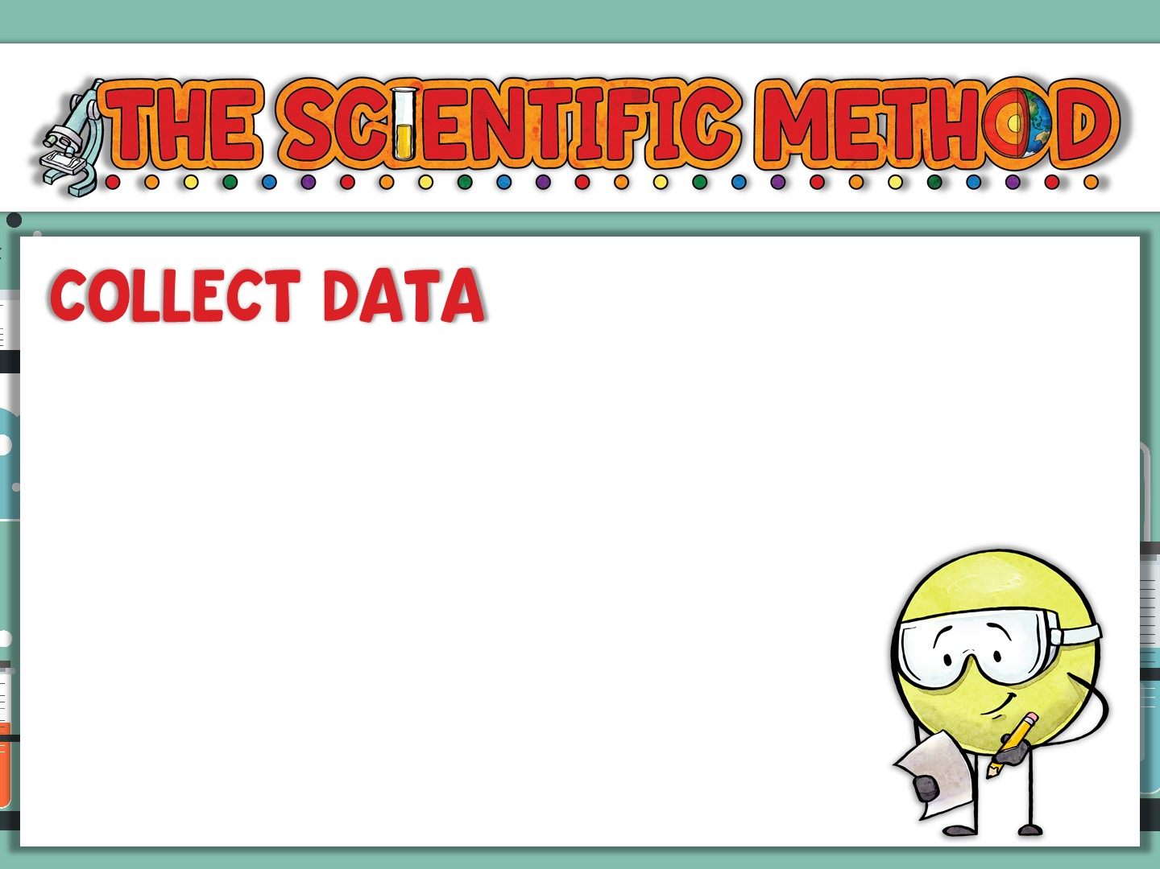
Collect all of your ______ and ____________ in a journal. Record it __________ and don’t try to make it ____ your __________!
Always use correct ______ of
_____________ and be sure to write
down the _____ and date.
data
observations
accurately
fit
hypothesis
units
measurement
time

Slide 7
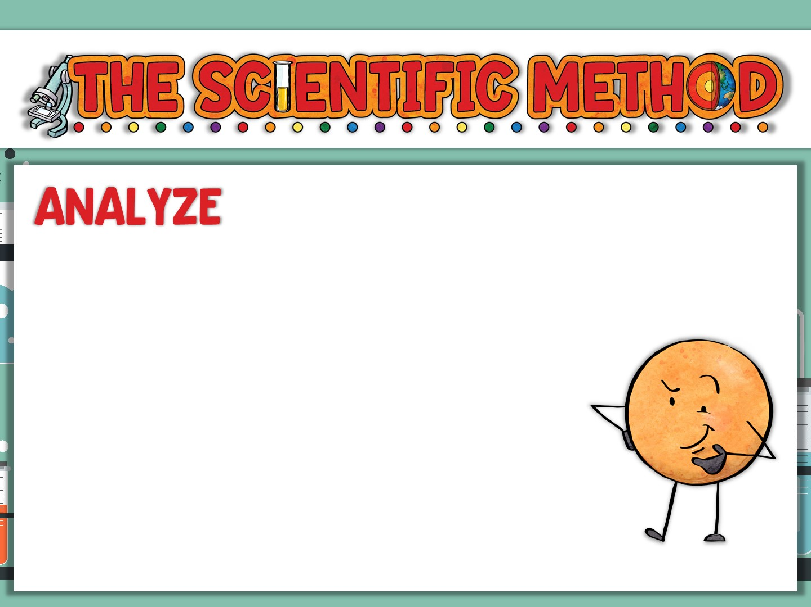
________ and analyze your _____. It may help to use a ______ or ______ to help you
________ your data. Always ask
yourself if you got any unexpected
______ or ______ that might
mean a problem with your experiment.
Organize
data
chart
graph
visualize
results
errors

Slide 8
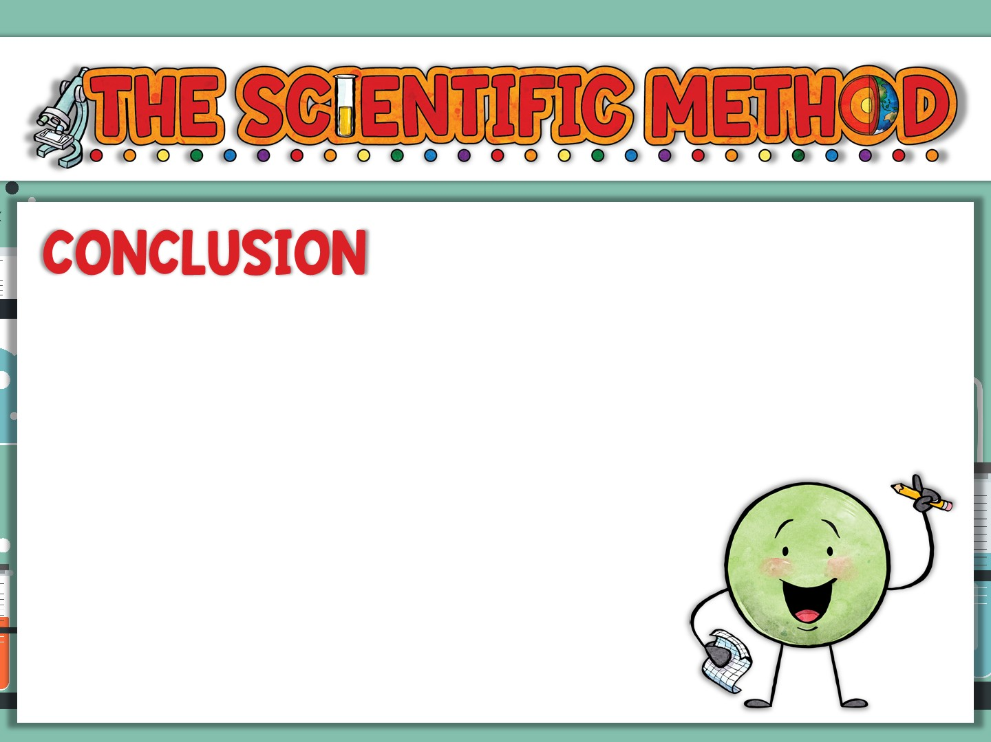
Developing a __________ is the point where you reach a _____________ about your __________.
Was it _____ or ______?
If it was wrong, you may go _____
to ______ it and ________ your
experiment.
conclusion
determination
hypothesis
right
wrong
back
revise
redesign

Slide 9
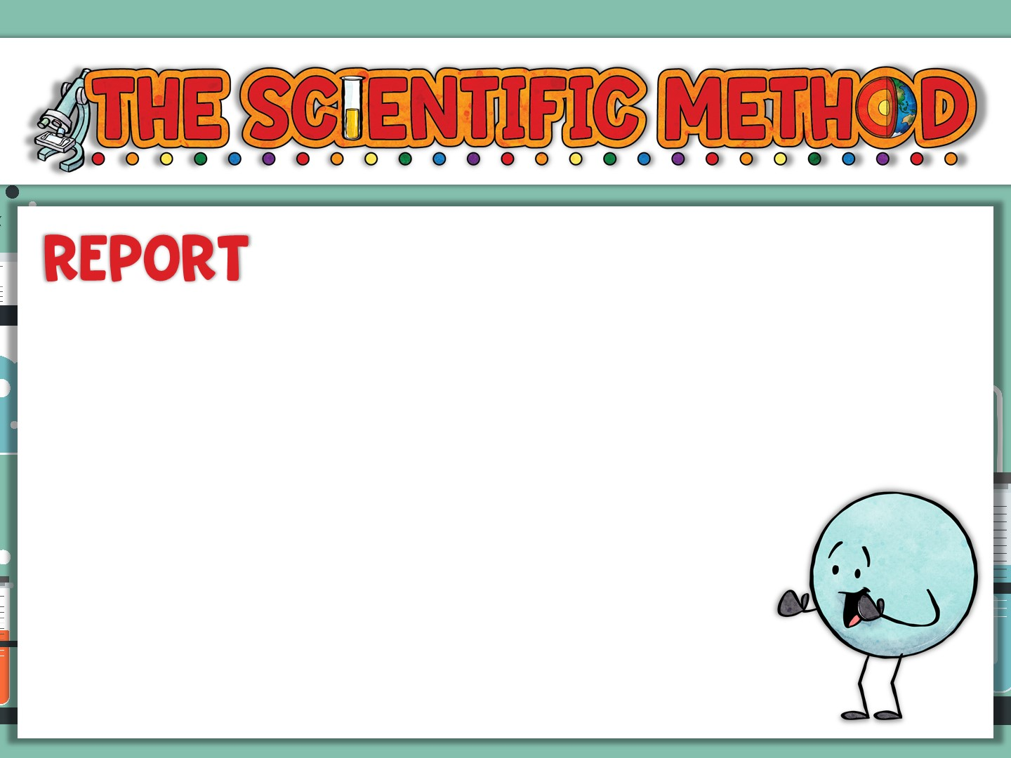
Regardless if your __________ was _____ or ______, you now have ___________ to ______!
It could be a ______ to your classmates,
a _______ ____, or even published
in a _______ _______. Other scientists
want to know what you have found!
hypothesis
right
wrong
information
share
report
science
fair
science
journal

